Slide 1

An Image Dataset for
Benchmarking Recommender Systems with Raw Pixels
Yu Cheng^{1,2}, Yunzhu Pan², Jiaqi Zhang², Yongxin Ni², Aixin Sun³ , and Fajie Yuan²
¹ Zhejiang University; ² Westlake University
³ Nanyang Technological University

Slide 2
Overview
1. Background and Motivation
2. PixelRec Dataset
3. Contribution
4. Future Works

Slide 3
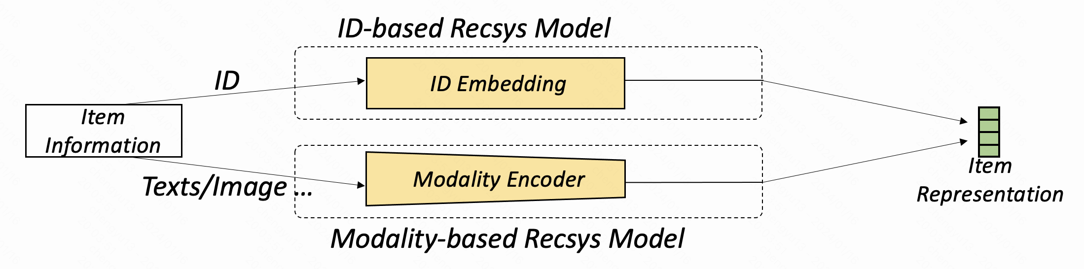

Background
Encouraged by the success of LLMs
ID-based Recsys
Modality-based Recsys
Targeting at foundation models in Recsys

Slide 4
Background
Active trend
Limited research
BUT particular important in art, short videos …

Slide 5
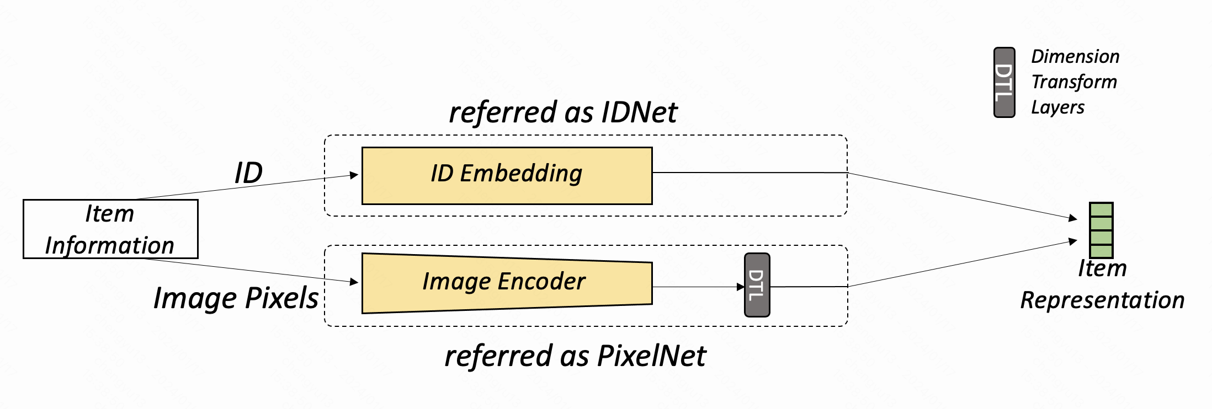
Background
Fig. Item representation module in recommender model
PixelNet
- Only take raw images as input of item (remove item ID in recommender model)
- Train recommender model and image encoder under end to end manner
(guarantee high accuracy)

Slide 6
Motivation
Key weaknesses of existing visual recsys dataset
Pre-extracted feature vectors
_{CV}
_{RS}
(1) Mismatch in tasks and vocabs
Notes:
Fails when users and items have few interactions, e.g., the cold-start setting.
Pre-trained IDRec is not transferable across platforms given that userIDs and itemIDs are in general not shareable in practice.
Pure IDRec cannot benefit from the technical advances in other communities NLP and CV.

Slide 7
Motivation
Key weaknesses of existing visual recsys dataset
Pre-extracted feature vectors
Updated vision models
_{CV}
_{RS}
_{RS}
(1) Mismatch in tasks and vocabs
(2) Hindering technological advancement

Slide 8

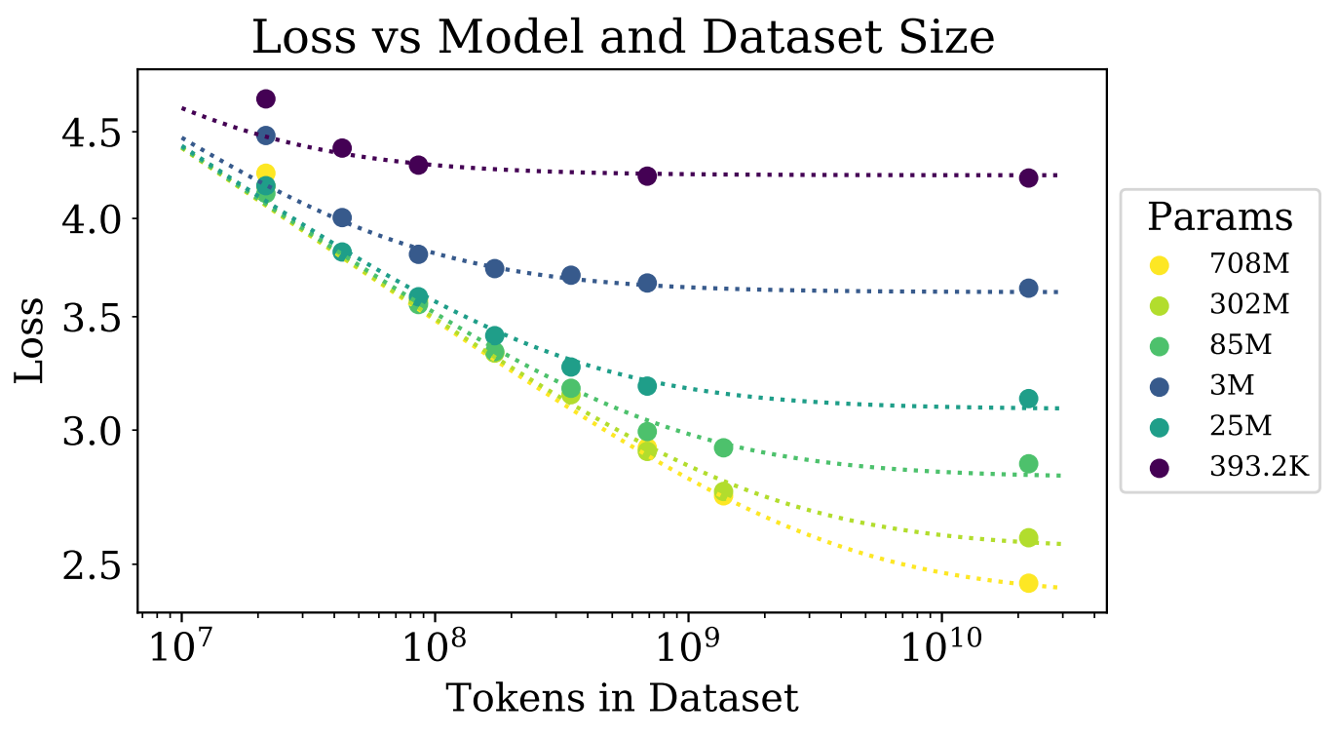
Motivation
Key weaknesses of existing visual recsys dataset
Behance[1], Flickr[2], KuaiRec[3]
Pinterest[4], WikiMedia[5]
Pre-extracted feature vectors
Updated vision models
Scaling law in LLMs
_{CV}
_{RS}
_{RS}
(1) Mismatch in tasks and vocabs
(2) Hindering technological advancement
(3) Limited scale

Slide 9

Not a typical visual recommendation scenario
E-commence dataset
Amazon[6], HM[7], GEST[8]
Sales
Content
“ A black and white football ”
Price
User demand
Brand
- E-commence is not a content- driven scenario
- Images are relatively simple and easy to describe
User
Behavior

Slide 10
Overview
1. Background and Motivation
2. PixelRec Dataset
3. Contribution
4. Future Works

Slide 11
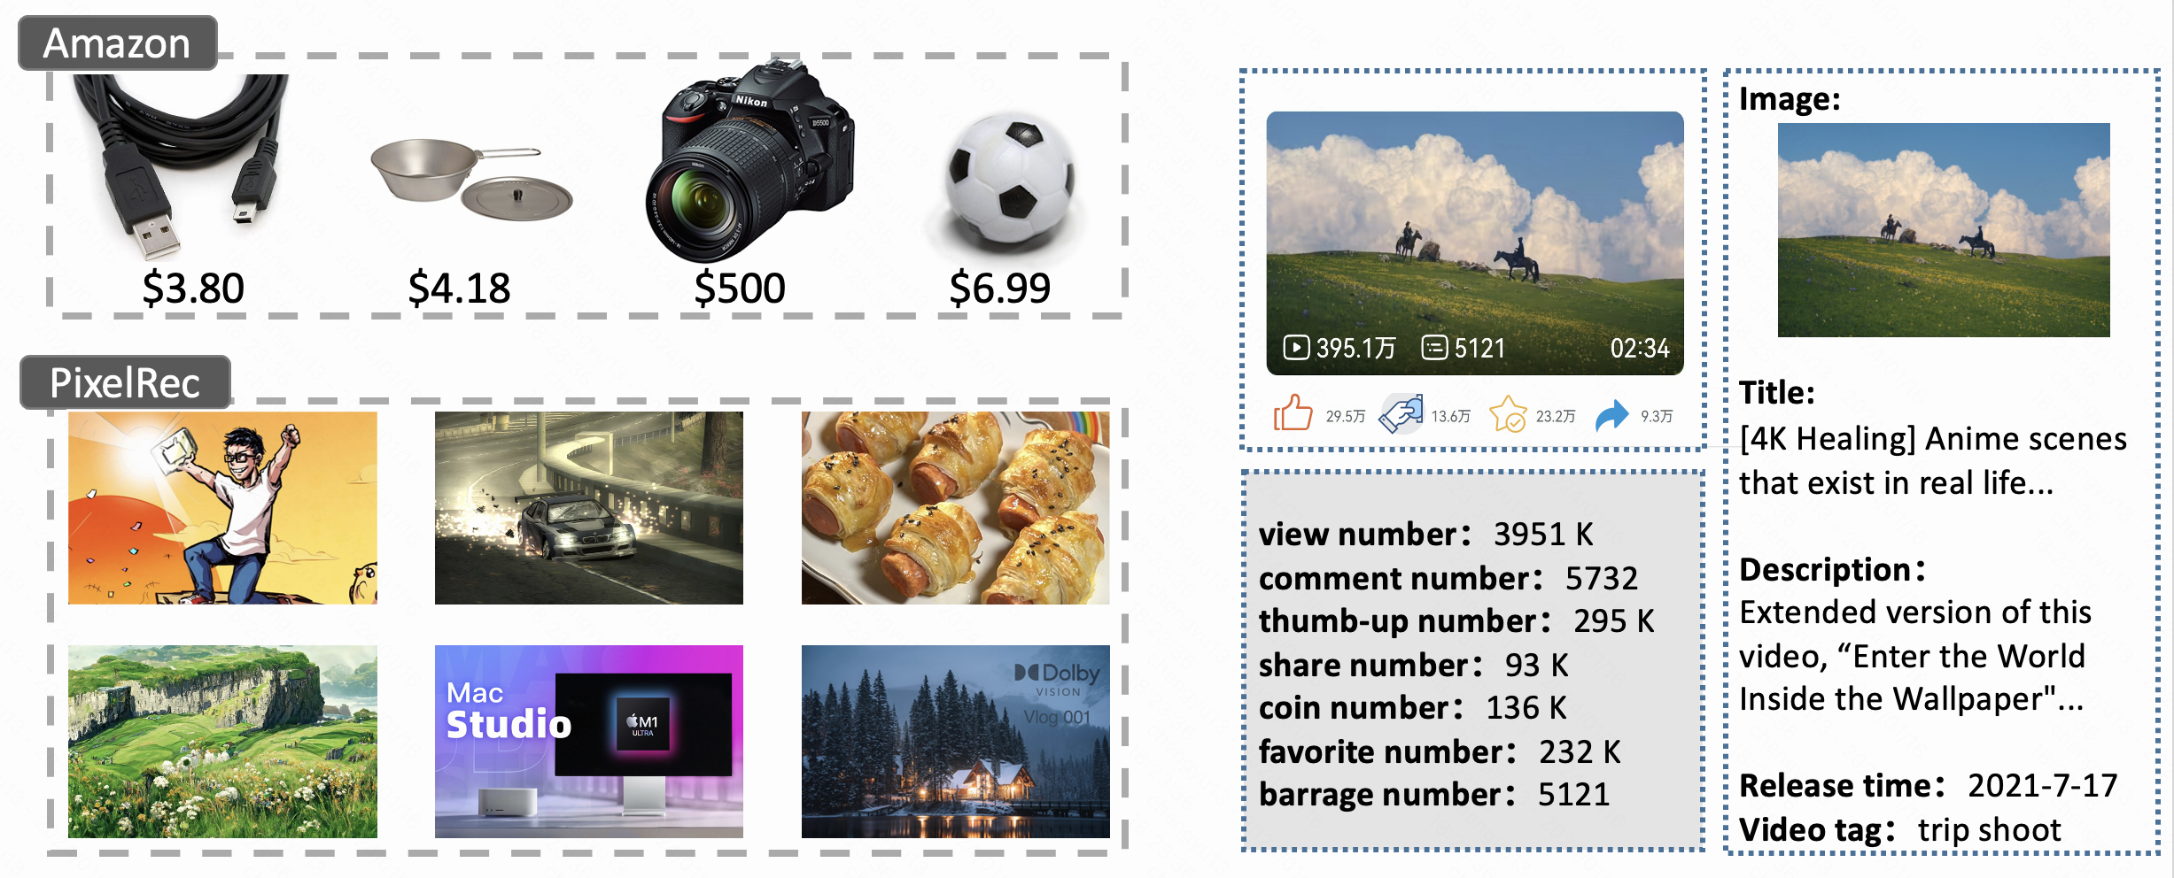
PixelRec (Overview)
Raw images
Rich features
Large scale
Diversity of visual elements
Content-driven scenario
Pivot role of image
Notes:
Modality-based Recsys (MoRec) in past years
Was mainly used to solve cold-start, instead of the regular settings.
Need the help of item ID features.
These item modality encoder developed in the past years (e.g., word embedding) are not as expressive as typical item ID embeddings.
The situation is different now:
The recent great success of pre-trained modality encoders(e.g., BERT, Swin) .

Slide 12


PixelRec (Details)
First step: collect videos
Second step: video expanding
Main channel
(various topic)
Expand through external links to related videos
An online video
streaming platform
(unlogged)
request page update
User feedback :
comments
bullet comments
22 vertical channels
(each with one specific topic:
cartoons, sports, foods ..)
Video features :
cover, title, description, tag
view_number, comment_number …
Third step: interaction & other features
From September 2021 to October 2022, 13 months in total

Slide 13
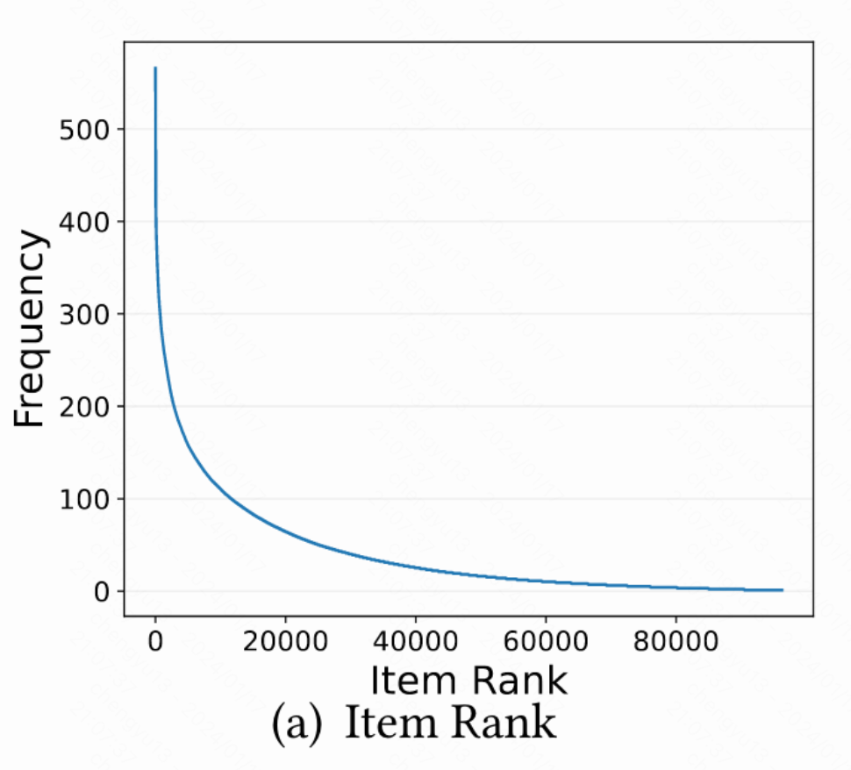
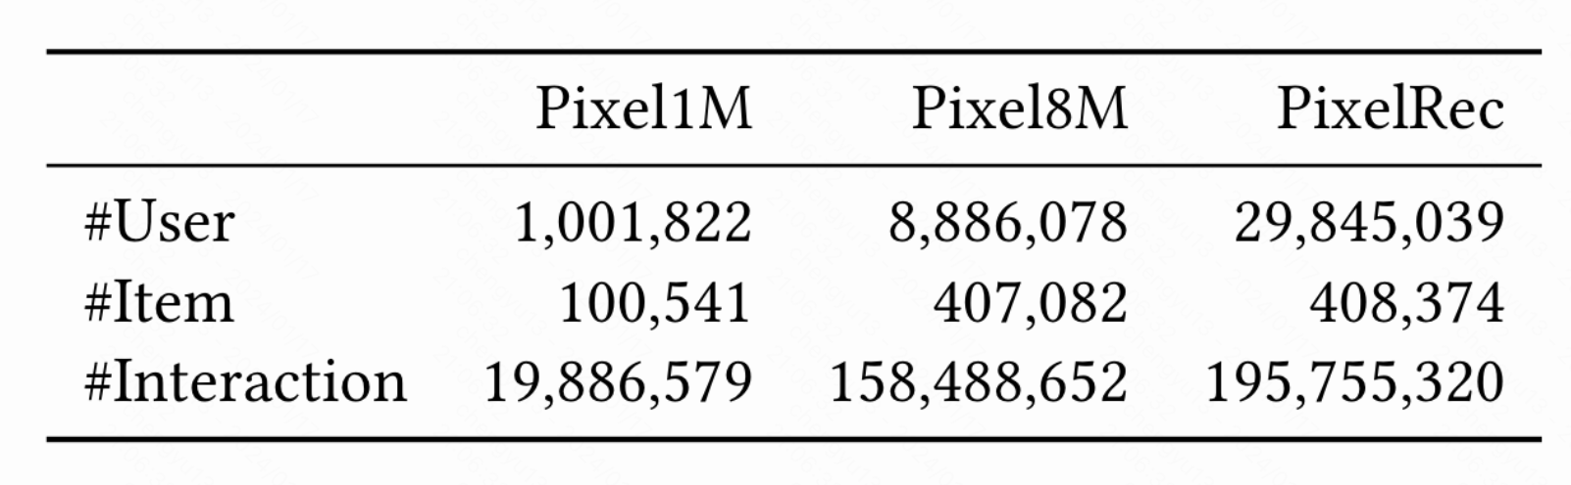
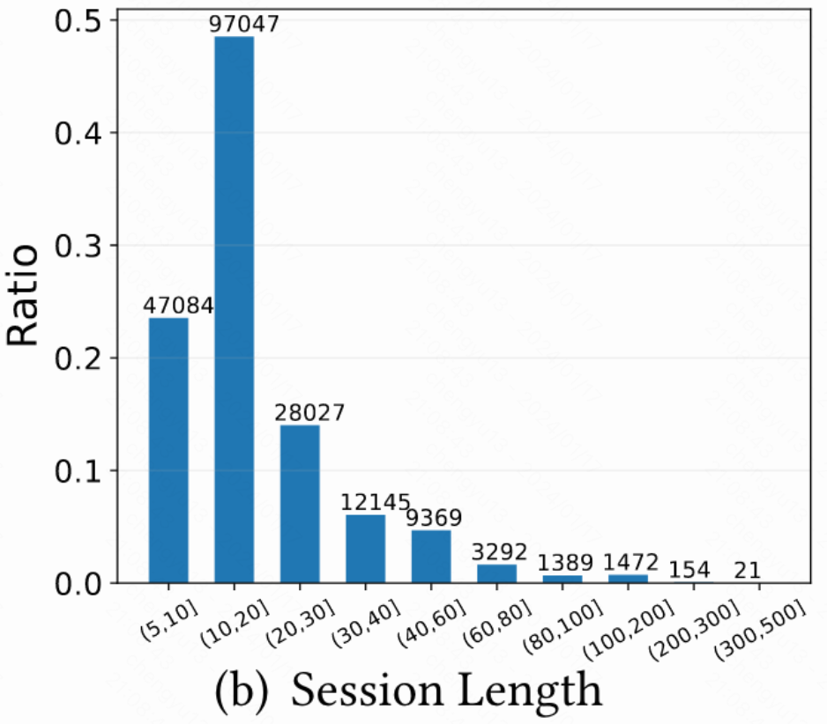
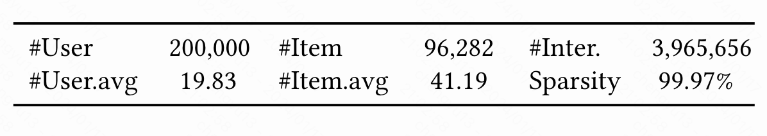
PixelRec (Statistics)
Statistics of Pixel200K

Slide 14
Overview
1. Background and Motivation
2. PixelRec Dataset
3. Contribution
4. Future Works

Slide 15
Contribution
PixelRec dataset
PixelRec benchmark
Exploratory results
Baseline algorithms & Operating pipeline
Notes:
Modality-based Recsys (MoRec) in past years
Was mainly used to solve cold-start, instead of the regular settings.
Need the help of item ID features.
These item modality encoder developed in the past years (e.g., word embedding) are not as expressive as typical item ID embeddings.
The situation is different now:
The recent great success of pre-trained modality encoders(e.g., BERT, Swin) .

Slide 16
Contribution (PixelRec dataset)
PixelRec dataset
High-resolution raw images
Effective and precise image-based recommendation
Notes:
Modality-based Recsys (MoRec) in past years
Was mainly used to solve cold-start, instead of the regular settings.
Need the help of item ID features.
These item modality encoder developed in the past years (e.g., word embedding) are not as expressive as typical item ID embeddings.
The situation is different now:
The recent great success of pre-trained modality encoders(e.g., BERT, Swin) .

Slide 17
Contribution (PixelRec dataset)
PixelRec dataset
High-resolution raw images
Rich features
Short-video/ multimodal recommendation
Short video domain
Notes:
Modality-based Recsys (MoRec) in past years
Was mainly used to solve cold-start, instead of the regular settings.
Need the help of item ID features.
These item modality encoder developed in the past years (e.g., word embedding) are not as expressive as typical item ID embeddings.
The situation is different now:
The recent great success of pre-trained modality encoders(e.g., BERT, Swin) .

Slide 18
Contribution (PixelRec dataset)
PixelRec dataset
High-resolution raw images
Challenging and high-quality benchmark for image recommendation tasks
Diversity of visual elements
Facilitate Bridging of RS and CV domains
Pivot role of image in user decision making
Notes:
Modality-based Recsys (MoRec) in past years
Was mainly used to solve cold-start, instead of the regular settings.
Need the help of item ID features.
These item modality encoder developed in the past years (e.g., word embedding) are not as expressive as typical item ID embeddings.
The situation is different now:
The recent great success of pre-trained modality encoders(e.g., BERT, Swin) .

Slide 19
Contribution (PixelRec dataset)
PixelRec dataset
High-resolution raw images
Large scale
Pre-training resource for foundation vision recommendation models
Diversity of visual elements
Pivot role of image in user decision making
Notes:
Modality-based Recsys (MoRec) in past years
Was mainly used to solve cold-start, instead of the regular settings.
Need the help of item ID features.
These item modality encoder developed in the past years (e.g., word embedding) are not as expressive as typical item ID embeddings.
The situation is different now:
The recent great success of pre-trained modality encoders(e.g., BERT, Swin) .

Slide 20
Contribution (PixelRec dataset)
PixelRec dataset
Content-driven scenario
Developing recommender models that prioritize item contents.
Notes:
Modality-based Recsys (MoRec) in past years
Was mainly used to solve cold-start, instead of the regular settings.
Need the help of item ID features.
These item modality encoder developed in the past years (e.g., word embedding) are not as expressive as typical item ID embeddings.
The situation is different now:
The recent great success of pre-trained modality encoders(e.g., BERT, Swin) .

Slide 21
Contribution (PixelRec dataset)
PixelRec dataset
Pivot role of image in user decision making
Studying preference models founded solely on images
Notes:
Modality-based Recsys (MoRec) in past years
Was mainly used to solve cold-start, instead of the regular settings.
Need the help of item ID features.
These item modality encoder developed in the past years (e.g., word embedding) are not as expressive as typical item ID embeddings.
The situation is different now:
The recent great success of pre-trained modality encoders(e.g., BERT, Swin) .

Slide 22
Contribution (PixelRec benchmark)
- 9 recommender models
- non-sequential : MF, DSSM, FM
- sequential : GRU4Rec, NextItNet, SR-GNN, SASRec, BERT4Rec, LightSANs
- 9 image encoders
- Transformer backbone: CLIP-ViT, Swin Transformer tiny, Swin Transformer base, BEiT
- CNN backbone: ResNet50, CLIP-RN50, CLIP-RN50x4, CLIP-RN50x16, CLIP-RN50x64
- Exhaustive search on hyper-parameters of IDNet baselines
- embedding size [128, 512, 1024, 2048, 4096, 8192]
- batch size [64, 128, 512, 1024]
…

Slide 23
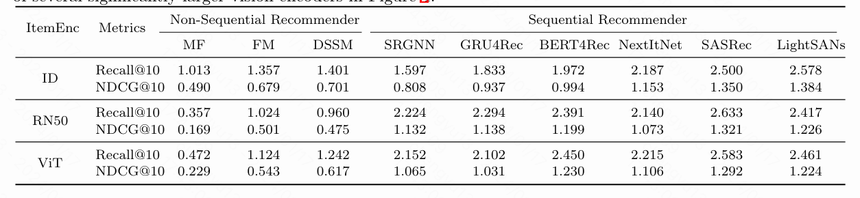

Contribution (Exploratory results)
Observation:
For Non-Sequential Recommender:
PixelNet << corresponding IDNet counterparts
For Sequential Recommender:
PixelNet corresponding IDNet counterparts
$≈$
Notes:
Modality-based Recsys (MoRec) in past years
Was mainly used to solve cold-start, instead of the regular settings.
Need the help of item ID features.
These item modality encoder developed in the past years (e.g., word embedding) are not as expressive as typical item ID embeddings.
The situation is different now:
The recent great success of pre-trained modality encoders(e.g., BERT, Swin) .

Slide 24
Contribution (Exploratory results)
Conclusion:
1. Adopting sequential recommender backbone and end2end training strategy, PixelNet perform satisfactorily in regular recommendation setting
2. The performance of PixelNet may be significantly influenced by the specific recommendation backbone network and training approach used
Notes:
Modality-based Recsys (MoRec) in past years
Was mainly used to solve cold-start, instead of the regular settings.
Need the help of item ID features.
These item modality encoder developed in the past years (e.g., word embedding) are not as expressive as typical item ID embeddings.
The situation is different now:
The recent great success of pre-trained modality encoders(e.g., BERT, Swin) .

Slide 25
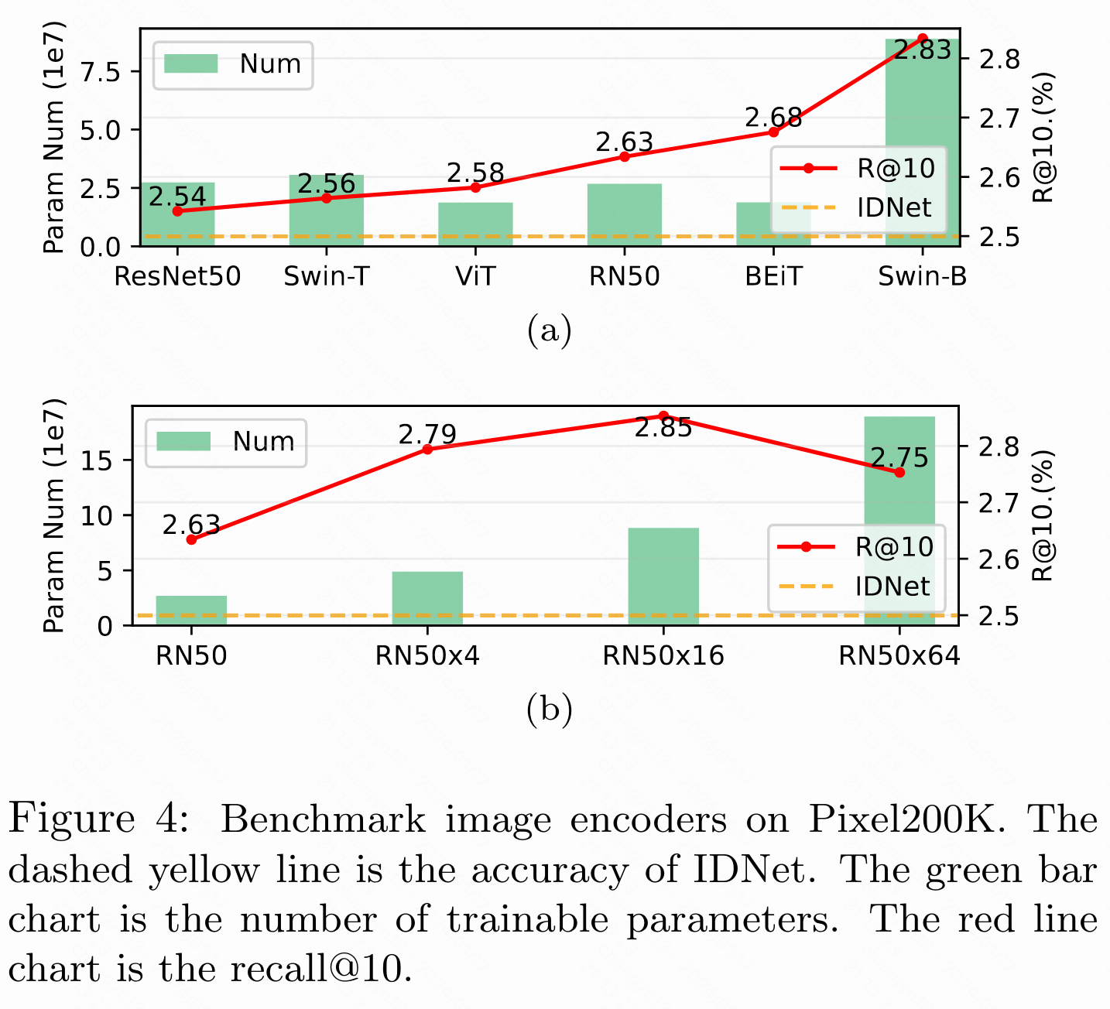
Contribution (Exploratory results)
Conclusion:
Larger image encoders do lead to improved performance, but only up to a certain point
Both recommendation architectures and image encoders play important roles in the effectiveness of PixeNet
Notes:
Modality-based Recsys (MoRec) in past years
Was mainly used to solve cold-start, instead of the regular settings.
Need the help of item ID features.
These item modality encoder developed in the past years (e.g., word embedding) are not as expressive as typical item ID embeddings.
The situation is different now:
The recent great success of pre-trained modality encoders(e.g., BERT, Swin) .

Slide 26
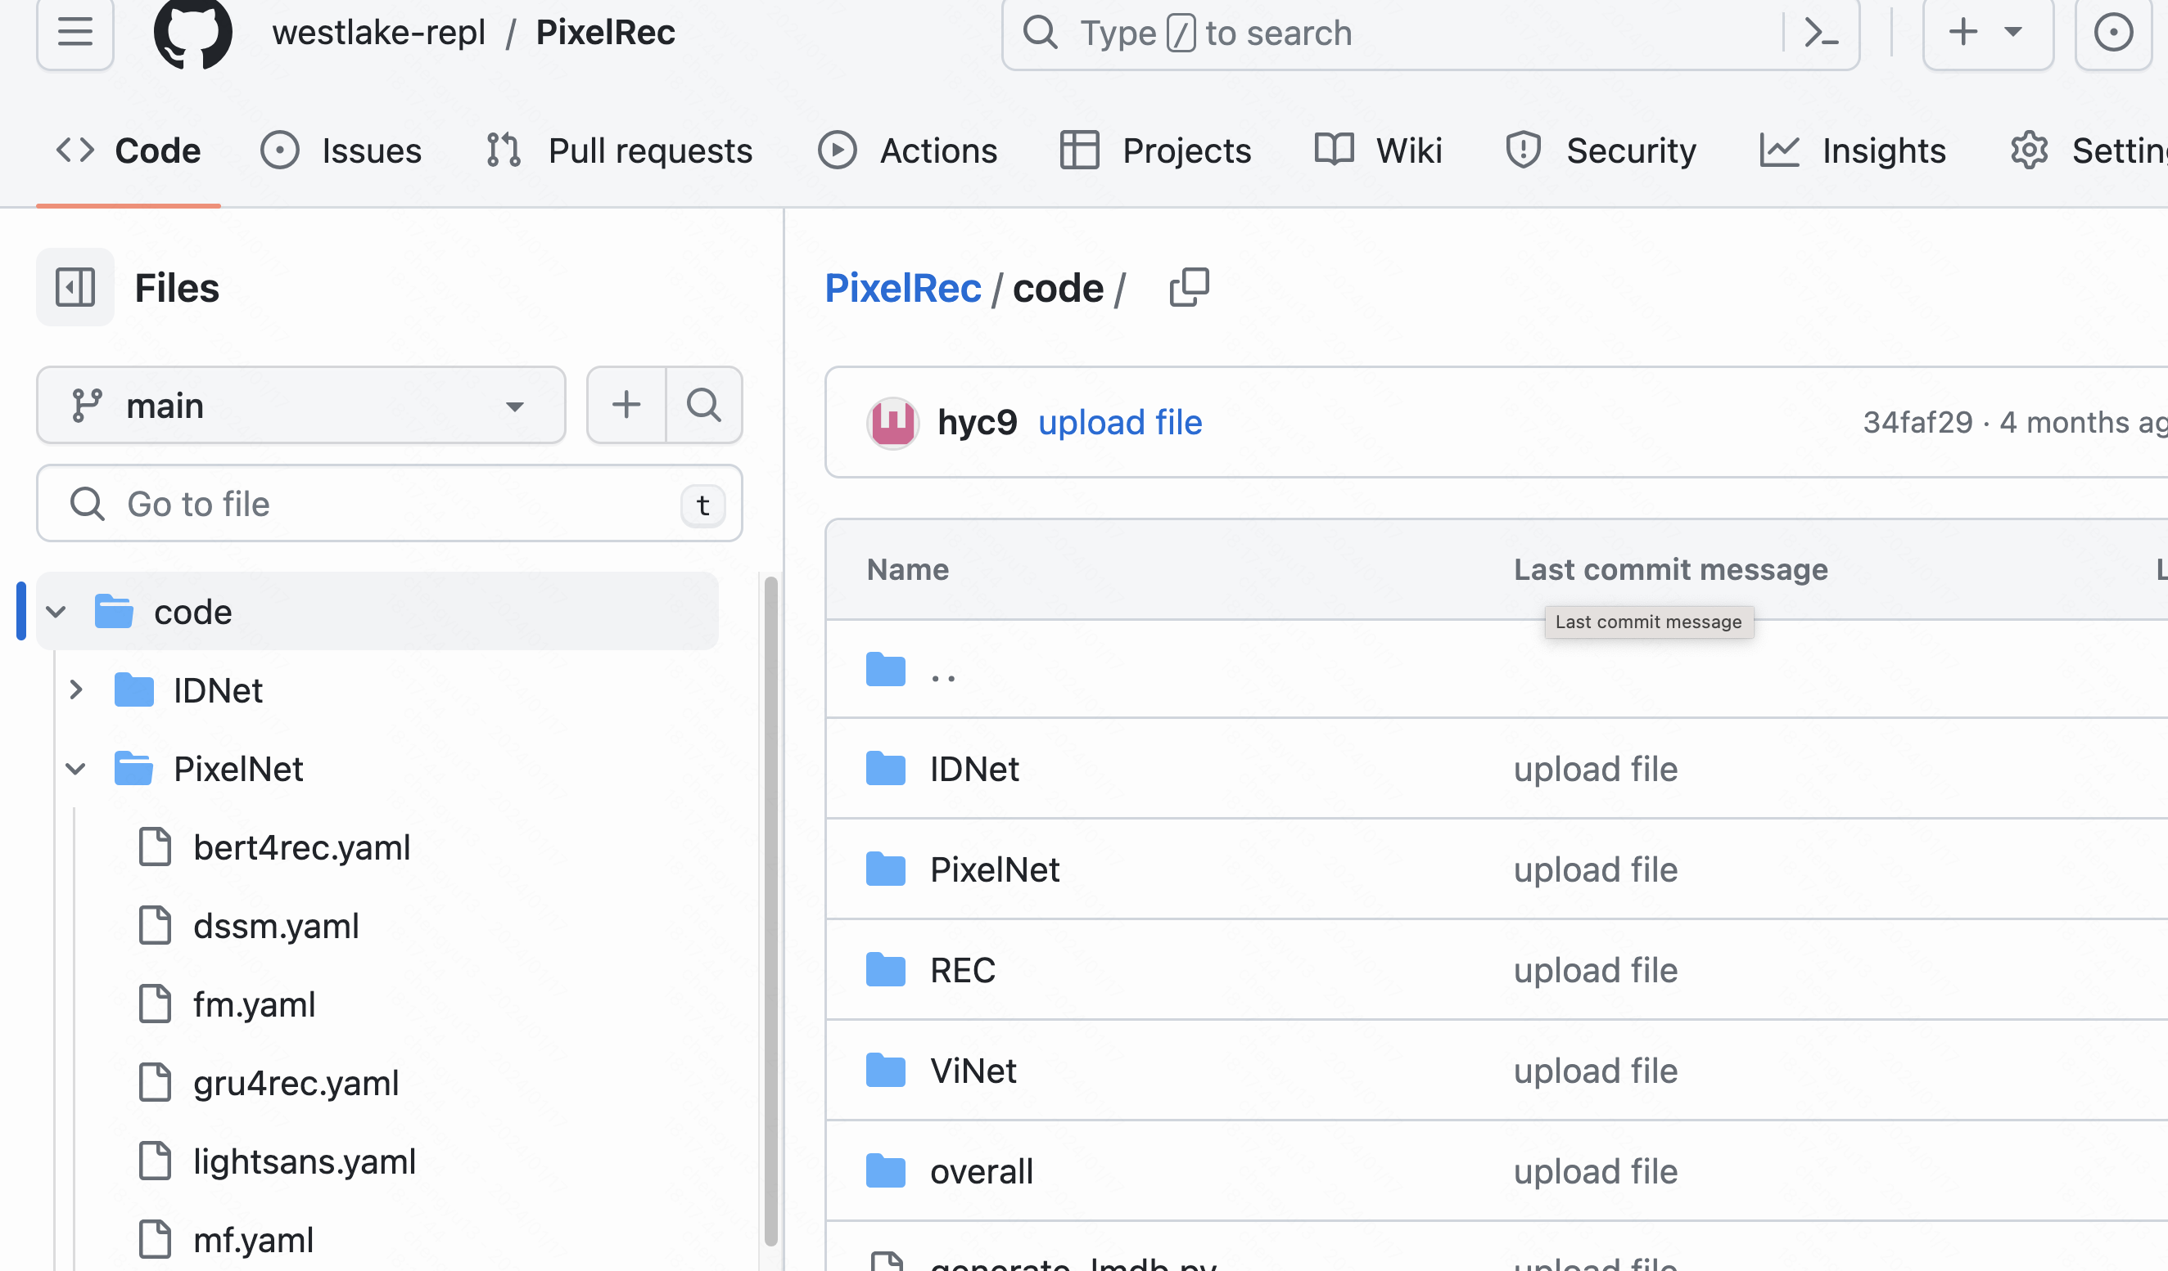
Contribution (Baseline algorithms & Operating pipeline)
Abundant Baseline algorithms
Traditional ID-based recommender
Traditional visual recommender
Pixel-based recommender
Complete operating pipeline
Data processing
Model loading
Model training
Model inference
Hyper-parameter record
….
Access link : https://github.com/westlake-repl/PixelRec
Notes:
Modality-based Recsys (MoRec) in past years
Was mainly used to solve cold-start, instead of the regular settings.
Need the help of item ID features.
These item modality encoder developed in the past years (e.g., word embedding) are not as expressive as typical item ID embeddings.
The situation is different now:
The recent great success of pre-trained modality encoders(e.g., BERT, Swin) .

Slide 27
Overview
Background and Motivation
PixelNet Dataset
Contribution
Future Works

Slide 28
Future works
Reducing computation consumption of end2end training
Effective hyper-parameter tuning of PixelNet
Building foundation vision recommender models
Notes:
Modality-based Recsys (MoRec) in past years
Was mainly used to solve cold-start, instead of the regular settings.
Need the help of item ID features.
These item modality encoder developed in the past years (e.g., word embedding) are not as expressive as typical item ID embeddings.
The situation is different now:
The recent great success of pre-trained modality encoders(e.g., BERT, Swin) .

Slide 29

An Image Dataset for
Benchmarking Recommender Systems with Raw Pixels
Yu Cheng^{1,2}, Yunzhu Pan², Jiaqi Zhang², Yongxin Ni², Aixin Sun³ , and Fajie Yuan²

Slide 30
Reference
[1] Ruining He, Chen Fang, Zhaowen Wang, and Julian McAuley. 2016. Vista: A visually, socially, and temporally-aware model for artistic recommendation. In Proceedings of the 10th ACM conference on recommender systems. 309–316.
[2] Le Wu, Lei Chen, Richang Hong, Yanjie Fu, Xing Xie, and Meng Wang. 2019. A hierarchical attention model for social contextual image recommendation. IEEE Transactions on Knowledge and Data Engineering (2019).
[3] C. Gao, S. Li, W. Lei, J. Chen, B. Li, P. Jiang, X. He, J. Mao, and T.-S. Chua, Kuairec: A fully-observed dataset and insights for evaluating recommender systems, in Proceedings of the 31st ACM International Conference on Information & Knowledge Management, 2022, pp. 540–550.
[4] Xue Geng, Hanwang Zhang, Jingwen Bian, and Tat-Seng Chua. 2015. Learning image and user features for recommendation in social networks. In ICCV.
Notes:
Modality-based Recsys (MoRec) in past years
Was mainly used to solve cold-start, instead of the regular settings.
Need the help of item ID features.
These item modality encoder developed in the past years (e.g., word embedding) are not as expressive as typical item ID embeddings.
The situation is different now:
The recent great success of pre-trained modality encoders(e.g., BERT, Swin) .

Slide 31
Reference
[5] Denis Parra, Antonio Ossa-Guerra, Manuel Cartagena, Patricio Cerda-Mardini, and Felipe del Rio. 2021. VisRec: A Hands-on Tutorial on Deep Learning for Visual Recommender Systems. In 26th International Conference on Intelligent User Interfaces-Companion. 5–6.
[6] Julian McAuley, Christopher Targett, Qinfeng Shi, and Anton Van Den Hengel. 2015. Image-based recommendations on styles and substitutes. In SIGIR.
[7] https://www.kaggle.com/competitions/h-and-m-personalized-fashionrecommendations
[8] An Yan, Zhankui He, Jiacheng Li, Tianyang Zhang, and Julian McAuley. 2022. Personalized Showcases: Generating Multi-Modal Explanations for Recommendations.
Notes:
Modality-based Recsys (MoRec) in past years
Was mainly used to solve cold-start, instead of the regular settings.
Need the help of item ID features.
These item modality encoder developed in the past years (e.g., word embedding) are not as expressive as typical item ID embeddings.
The situation is different now:
The recent great success of pre-trained modality encoders(e.g., BERT, Swin) .

